Slide 1


CYBERWARFARE
GLOBAL ACADEMY OF TECHNOLOGY
Ideal Homes Township, Rajarajeshwari Nagar, Bengaluru – 560 098
Seminar Presentation
Presented By: Guided By:
THANMAI D L Prof. Jyoti Neeli
1GA18IS900

Slide 2
INDEX
Abstract
Introduction
Motivation
Problem Statement
Literature Survey
Methodology
Case Study
Countermeasures
Conclusion
References
18CSS84

Slide 3
ABSTRACT
With the development of automated and AI technology permeating into all sectors of public, private and industry life, the interconnectivity of once remote, siloed and air gapped systems is on the increase.
Whilst this maximize the effectivity of these systems, it is the connectivity, that can create a critical vulnerability.
This vulnerability, is the source of exploitative measures that refer to in the context of cyberwarfare.
18CSS84

Slide 4
INTRODUCTION
Cyber warfare is usually defined as a cyber attack or series of attacks that target a country.
It has the potential to wreak havoc on government and civilian infrastructure and disrupt critical systems, resulting in damage to the state and even loss of life.
It involves the actions by a nation, state or international organization to attack and attempt to damage another nation’s computer or information networks.
18CSS84

Slide 5
INTRODUCTION
Targets systems that are critical to maintaining a nation’s way of life, in part, to cause widespread panic and uncertainty.
These systems can include financial systems, energy power grids or plants, healthcare, water, communications systems, transport systems and food and agricultural systems.
IoT devices have been the backbone for the growth and development of this sector, with technologies utilizing both various systems, and data collection and use in a wider network in order to enable the infrastructure.
18CSS84

Slide 6
MOTIVATION
Military
  To gain control of key elements of an enemy nation’s cyberspace. An effective cyberattack could bring an enemy country’s military to its knees and secure what would have been an otherwise costly victory.
Civil
  Attacking the civil infrastructure of a nation directly impacts the people living and working in the country.
Hacktivism
  Involves hackers using cyberattacks to promote an ideology. Hacktivists can engage in cyber warfare by spreading propaganda or going after secrets and then exposing them to the rest of the world.
18CSS84

Slide 7
MOTIVATION
Income Generation
  Cyber warfare “soldiers” can engage in these kinds of attacks for their own financial benefit. If they are employed by the government, they can earn a fee for their services. Further, they could break the defenses of a financial institution and steal money for themselves.
Nonprofit Research
  Nonprofit research often reveals very valuable information that a country can use to solve a critical problem. For example, if a country is trying to develop a vaccine and another one already has it, cyber warfare could be used to steal information pertaining to their solution.
18CSS84

Slide 8
PROBLEM STATEMENT
Due to rapid technological advancements around the world, it is necessary to be aware of the downsides of advance technology as it can either destabilize or destruct critical systems.
18CSS84

Slide 9
LITERATURE SURVEY
Paper | Year | Author
Cyber Warfare & Inadvertent Escalation | 2020 | JM Acton
Cyber threats and vulnerabilities | 2020 | НТ Уринов, НК Сайидова
The Current Posture of Cyber Warfare and Cyber Terrorism | 2020 | MP Style, L Maglaras
Cyberwarfare–Associated Technologies and Countermeasures | 2020 | N Chelvachandran, S Kendzierskyj, Y Shah
Cyber safety in the era of cyber warfare | 2020 | RS Metzger
18CSS84

Slide 10
METHODOLOGY
Espionage – Spying on another country to steal secrets.
Sabotage – Steal information, destroy it, or leverage insider threats.
DoS – Prevent legitimate users from accessing a website by flooding it with fake requests.
Electrical Power Grid – Hacking the electrical power grid could give an attacker the ability to disable critical systems.
Propaganda – Attempts to control the minds and thoughts of people living in or fighting for a target country.
18CSS84

Slide 11
METHODOLOGY
Economic Disruption – Attack stock markets, payment systems, and banks to steal money or block people from accessing the funds they need.
Surprise Attacks – The cyber equivalent of attacks like Pearl Harbor and 9/11.
Technologies Targeted
18CSS84
Machine Vision | Light Detection
In-Vehicle Devices | In-vehicle sensors
GPS | Electronic devices
Acoustic Sensors | Maps
Radar | Odometrical sensors

Slide 12
CASE STUDY – RUSSIAN UKRAINIAN CYBERWARFARE
After the invasion, Russian hackers compromised several important Ukrainian organizations, including nuclear power companies, media firms and government entities, according to Microsoft.
On Mar. 1, when a missile strike against Kyiv's TV tower coincided with widespread destructive cyberattacks on Kyiv-based media.
Days later, Microsoft detected a Russian group on the networks of an unnamed Ukrainian nuclear power company, just as Russia's military occupied the Zaporizhzhya nuclear power station.
18CSS84

Slide 13
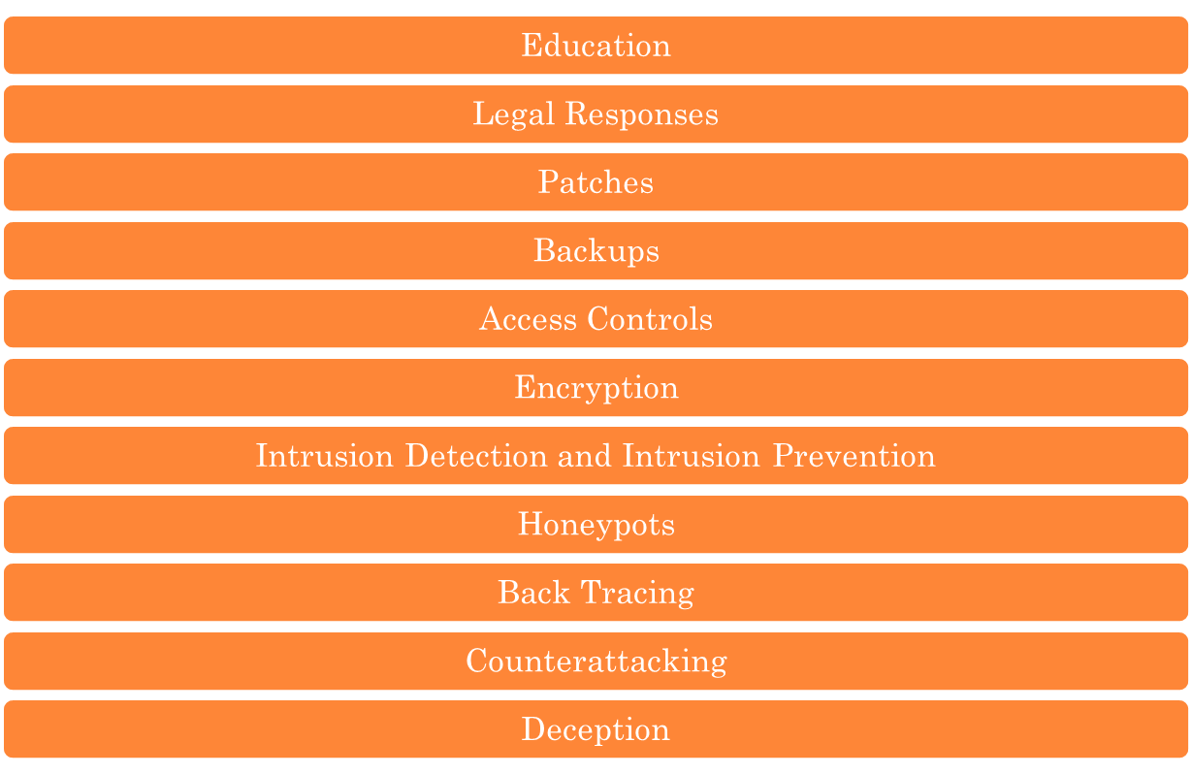
COUNTERMEASURES
18CSS84

Slide 14
CONCLUSION
As critical national infrastructure utilizes emerging technologies in order to maximize efficiency and effectivity, it also opens these critical networks and systems to non-conventional cyber-attacks.
The threat landscape is as complex as the system itself, with vulnerabilities open for exploitation by both independent operators, rogue state operatives, state backed threat actors and state mechanisms themselves.
18CSS84

Slide 15
REFERENCES
Robinson, Michael, Kevin Jones, and Helge Janicke. "Cyber warfare: Issues and challenges." Computers & security 49 (2015): 70-94.
Acton, James M. "Cyber warfare & inadvertent escalation." Dædalus 149, no. 2 (2020): 133-149.
Izycki, Eduardo, and Eduardo Wallier Vianna. "Critical Infrastructure: A Battlefield for Cyber Warfare?." In ICCWS 2021 16th International Conference on Cyber Warfare and Security, p. 454. Academic Conferences Limited, 2021.
18CSS84

Slide 16
THANK YOU
18CSS84

